Slide 1
Political radicalization
Hypothesis:
The wider is political choice, the more radical are the views.

Slide 2




Political radicalization
Hypothesis:
The wider is political choice, the more radical are the views.
Choice:
Partei der Arbeit der Schweiz
SVP/UDC
Bürgerlich-Demokratische Partei Schweiz
Evangelische Volkspartei der Schweiz
What is your political position?

Slide 3
Static files: images, css, javascript
in Static folder create a folder with your appname
{% load static %}
and in the template:
<img src="{% static ”appname/myimage.png" %}"/>
in vars_for_template: {‘myimage’: ”appname/myimage.png”}
then in template:
<img src="{% static myimage %}"/>

Slide 4
Dynamic set of choices
you have a field fruit
in Page class:
import random
class MyPage(Page):
def fruit_choices(self):
choices = ['apple', 'kiwi', 'mango']
random.shuffle(choices)
return choices

Slide 5
Creating session
class Subsession(BaseSubsession): def creating_session(self): for p in self.get_players(): p.something = random.randint(0, Constants.a) for g in self.get_groups() g.something = = random.randint(0, Constants.b)

Slide 6
Randomizing treatments
class Subsession(BaseSubsession): def creating_session(self):
if self.round_number == 1: for p in self.get_players(): p.treatment = random.choice([‘A’,’B’]
for g in self.get_groups() g.treatment = random.choice([‘A’,’B’]
else:
for p in self.get_players(): p.treatment = p.in_round(1).treatment

Slide 7
Individual vs. general appeals
Hypothesis:
When people make the decision about donations to charity, they donate more when they can see individual recipients of their donations.

Slide 8




Individual vs. general appeals
Initial Endowment: to check if ’rich’ are affected as ‘poor’
Distribute between two charities
One of two random images is picked to show

Slide 9
Loop through field forms
What if we do not know how many and which fields are there?
Or we are just too lazy to type them
{% for field in form %}
{% formfield field %}
{% endfor %}
OR:
{{ form }}

Slide 10
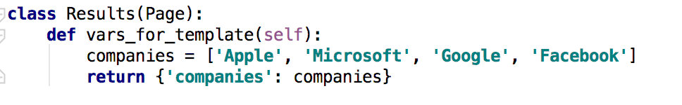
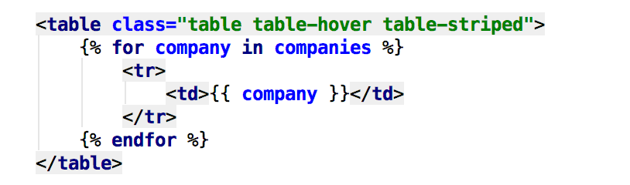
Loop through any lists
in pages
in template

Slide 11
Dynamic set of forms
in Page class:
class MyPage(Page):
def get_form_fields(self):
if self.player.treatment == 'A':
return ['a', 'b']
else:
return ['c', 'd']

Slide 12
Dynamic min/max
you have a field donation; different endowments
in Page class:
import random
class MyPage(Page):
def donation_max(self):
return self.player.endowment

Slide 13
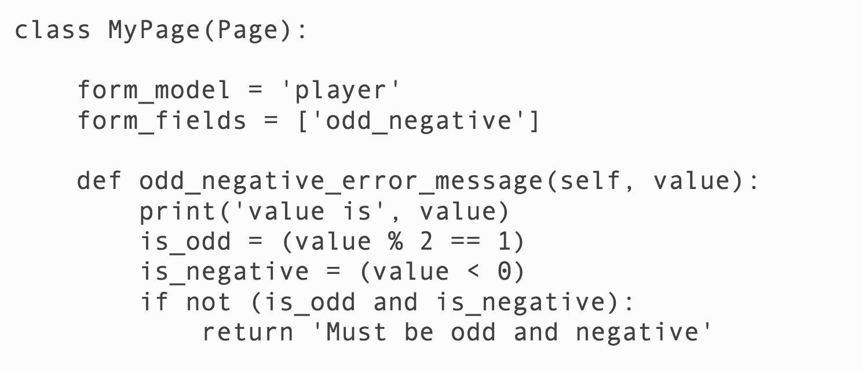
Checking conditions dynamically

Slide 14
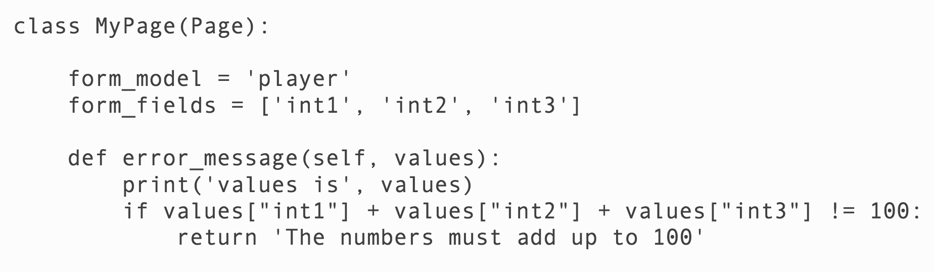
Checking conditions for several variables

Slide 15
Finalizing Ultimatum game
1. Control questions
2. Instructions at every page
3. Timeouts

Slide 16
{% include %}
To repeat instructions at each page:
TO: {% include 'ultimatum/instructions.html' %}

Slide 17
timeouts
class MyPage(Page):
form_model = 'player'
form_fields = ['accept']
timeout_seconds = 600
timeout_submission = {'accept': True}
def before_next_page(self):
if self.timeout_happened:
self.player.accept = random.choice([True, False])

Slide 18
Control questions for Ultimatum
After instructions are shown we need to check that people fully understand them.
Set of control questions
The correct answer depends on game parameters
They can’t continue before they give a correct answer

